Slide 1
Cookbook for Practice 8.2
实践8.2攻略
Cong Li 李聪

Slide 2


Control Printing 控制输出
In the class of ‘BinaryLogisticRegression’ in ‘logisticRegression.py’, remove printing of the loss as there can be too many for a large number of iterations
因为训练轮数很多时会大量地输出损失，所以在文件“logisticRegression.py”的“BinaryLogisticRegression”类型中，删除损失的输出。
Meanwhile, print something for every 100 iterations in training
同时，训练每100轮输出点信息

Slide 3
Multi-class Logistic Regression
多类对数几率回归 (1)
At the beginning of the file, import the class of data for one vs. rest 在文件起始处导入一对其余的数据的类型
The way to import a class
导入一个类型的写法

Slide 4

Multi-class Logistic Regression
多类对数几率回归 (1)
At the beginning of the file, import the class of data for one vs. rest 在文件起始处导入一对其余的数据的类型
Taking multi-class perceptron as the reference, write the new class for multi-class logistic regression, starting from the initialization function w/ the 4 input parameters
参考多类感知器，为多类对数几率回归写一个新的类型，从接受4个输入参数的初始化函数开始

Slide 5
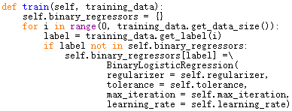
Multi-class Logistic Regression
多类对数几率回归 (2)
During training, create a binary classifier for each class label
在训练时，为每一个类别标记创建一个两类分类器

Slide 6

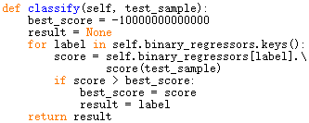
Multi-class Logistic Regression
多类对数几率回归 (3)
Then construct the one-vs.-rest data & train the classifiers
然后构造一对其余的数据，并训练分类器
Perform multi-class classification by comparing the scores
通过比较得分进行多类分类

Slide 7

Run It 运行之
Based on Practice 7.2, in file ‘test.py’, now replace the perceptron related lines w/ the logistic regression related lines
基于实践7.2，把感知器相关的语句换成对数几率回归相关的语句
Run it 运行之

Slide 8
The End

